Slide 1


Slide 2

Research Questions
How many people get the flu vaccine every year?
How many people get the flu every year?
Is there a correlation between the number of people getting the flu versus the number of people getting the flu shot?
How effective is the flu vaccine?
Are there any differences between the most densely populated states in relation to flu vaccination rates?

Slide 3
Influenza in the US: Fast Facts
CDC estimates each year 5% to 20% of the U.S. population contracts the flu, tens of thousands are hospitalized, and between 3,000 and 49,000 Americans die from flu-related illness
CDC estimates that the flu costs the United States about $27 billion each year
$10.4 billion a year in direct medical expenses
$16.3 billion in lost earnings annually
A chunk of those billions is spent formulating, growing and distributing millions of doses of the annual flu vaccine, which reduces the risk of illness by 40% - 60% at best
The flu vaccine is the only one that has to be reformulated and administered every year - grown in eggs, a process that takes around six months
2018 is the 100th anniversary of the 1918 global influenza pandemic
Also known as the Spanish flu, the worldwide outbreak infected ~ 500 million people, nearly a third of the planet's population then, and killed between 50M -100M victim
More than 25% of the U.S. population was sickened, and about 675,000 Americans died

Slide 4
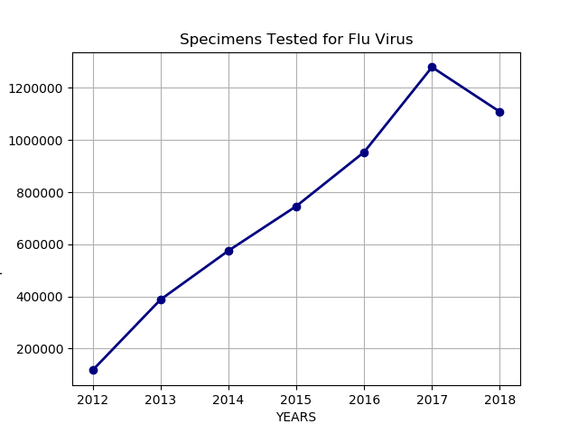
Influenza Viral Surveillance
Testing and typing has increased tremendously since the late 1990s
Many bacterial and viral infections that are not varieties of the influenza virus exhibit similar, if not identical, symptoms
Rhinovirus – which causes the common cold – is one of many that can result in “flu-like” or ILI – “Influenza-like-illness” diagnosis
Roughly 25% or less of all specimens tested each year test positive for a strain of influenza viruses of Types A & B
The flu vaccine is formulated each year to protect against what epidemiologists believe will be the most prevalent strains of Type A viruses in a given year
The flu vaccine won’t protect you from anything but the specific strains for which it is formulated
Efficacy is difficult to determine because of the high reported rate of ILI that isn’t caused by influenza

Slide 5
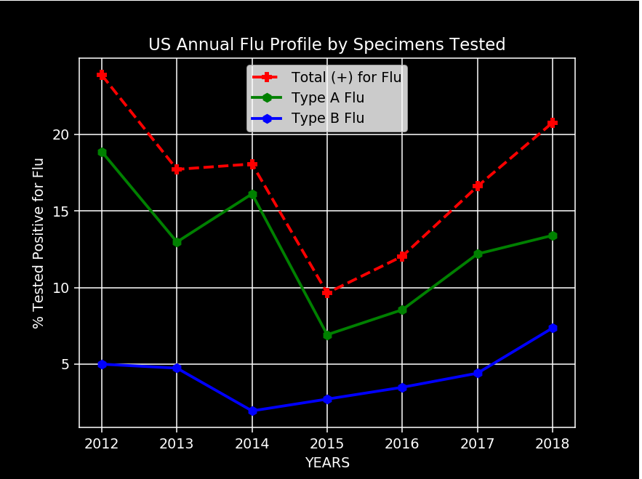
Profiling a Problem
Flu specimens tested each year provide a trend of flu type data
Type A flu viruses are more contagious and severe than Type B, and are the strains that we inoculate against
H1N1 (swine flu) and H3N2 (bird flu) variants are typically of the greatest concern as pandemic health risks
Flu seasons seemingly vary in severity due to the type of flu strain and the relative number of people that do not have any immunity against it

Slide 6
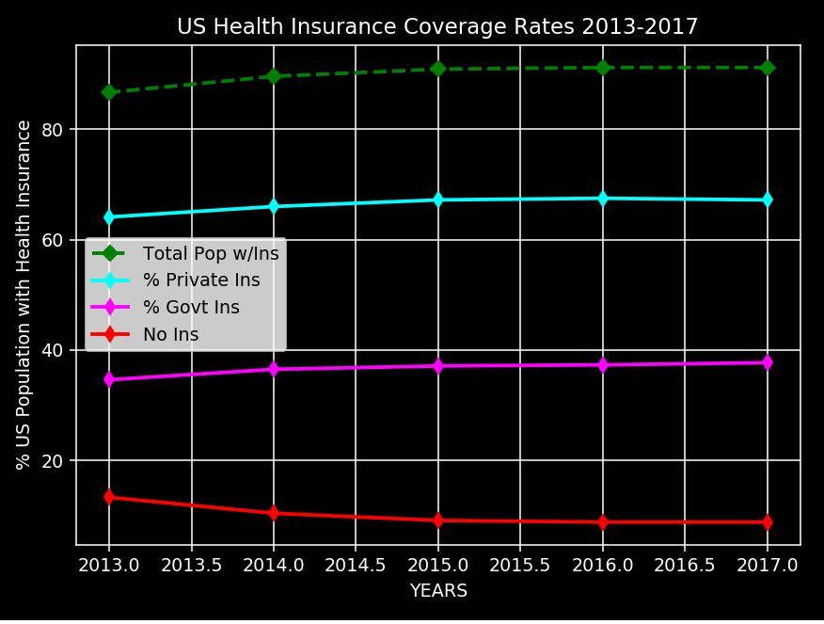
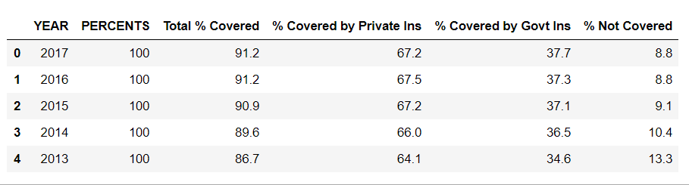
US Health Insurance Coverage
The flu vaccine is covered by all health insurance, although some require a small co-pay
As of 2017 US Census data on health care coverage reported that less than 9% of the US population was not covered by some form of health care
This information was significant when analyzing flu vaccine rates nation wide
We wanted to understand if not having health care coverage was a barrier to getting the vaccine
CDC estimated 41.8M Americans were vaccinated in the 2016-17 flu season, or about 13% of the population
91% of Americans have access to the vaccine, but only 13% get it
The more people that contract the flu, the faster and further it spreads

Slide 7
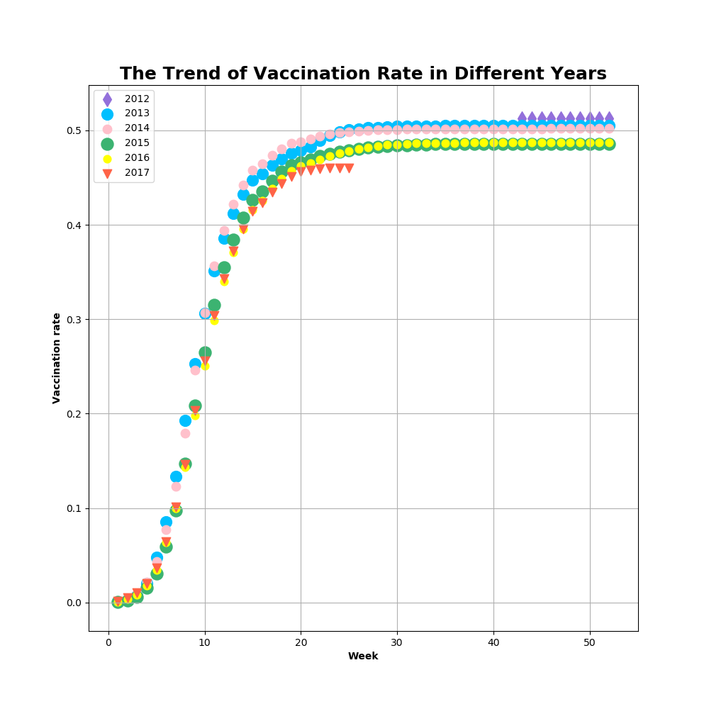

Slide 8
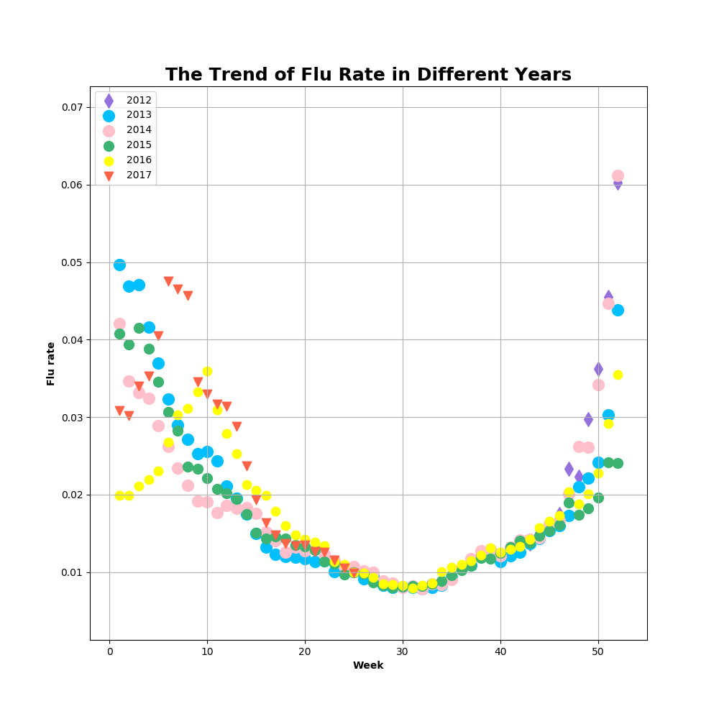

Slide 9
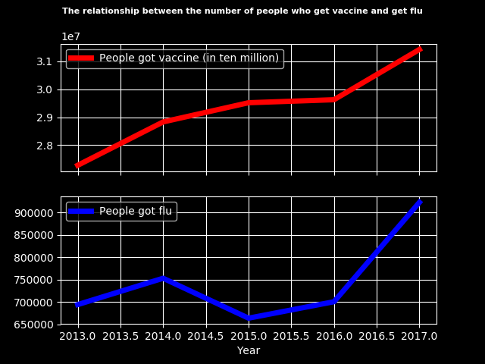

Slide 10

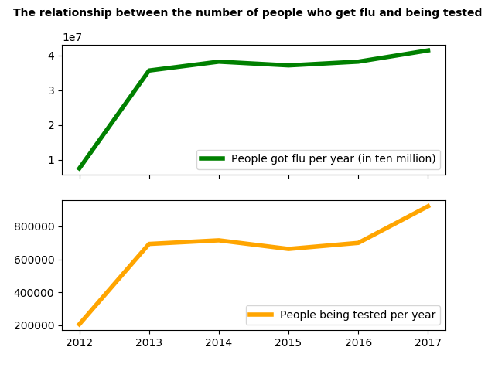




Slide 11
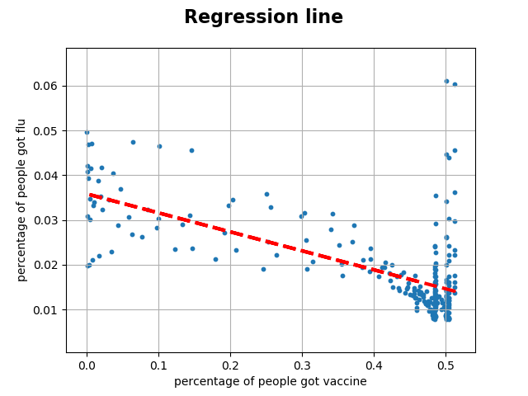

Slide 12
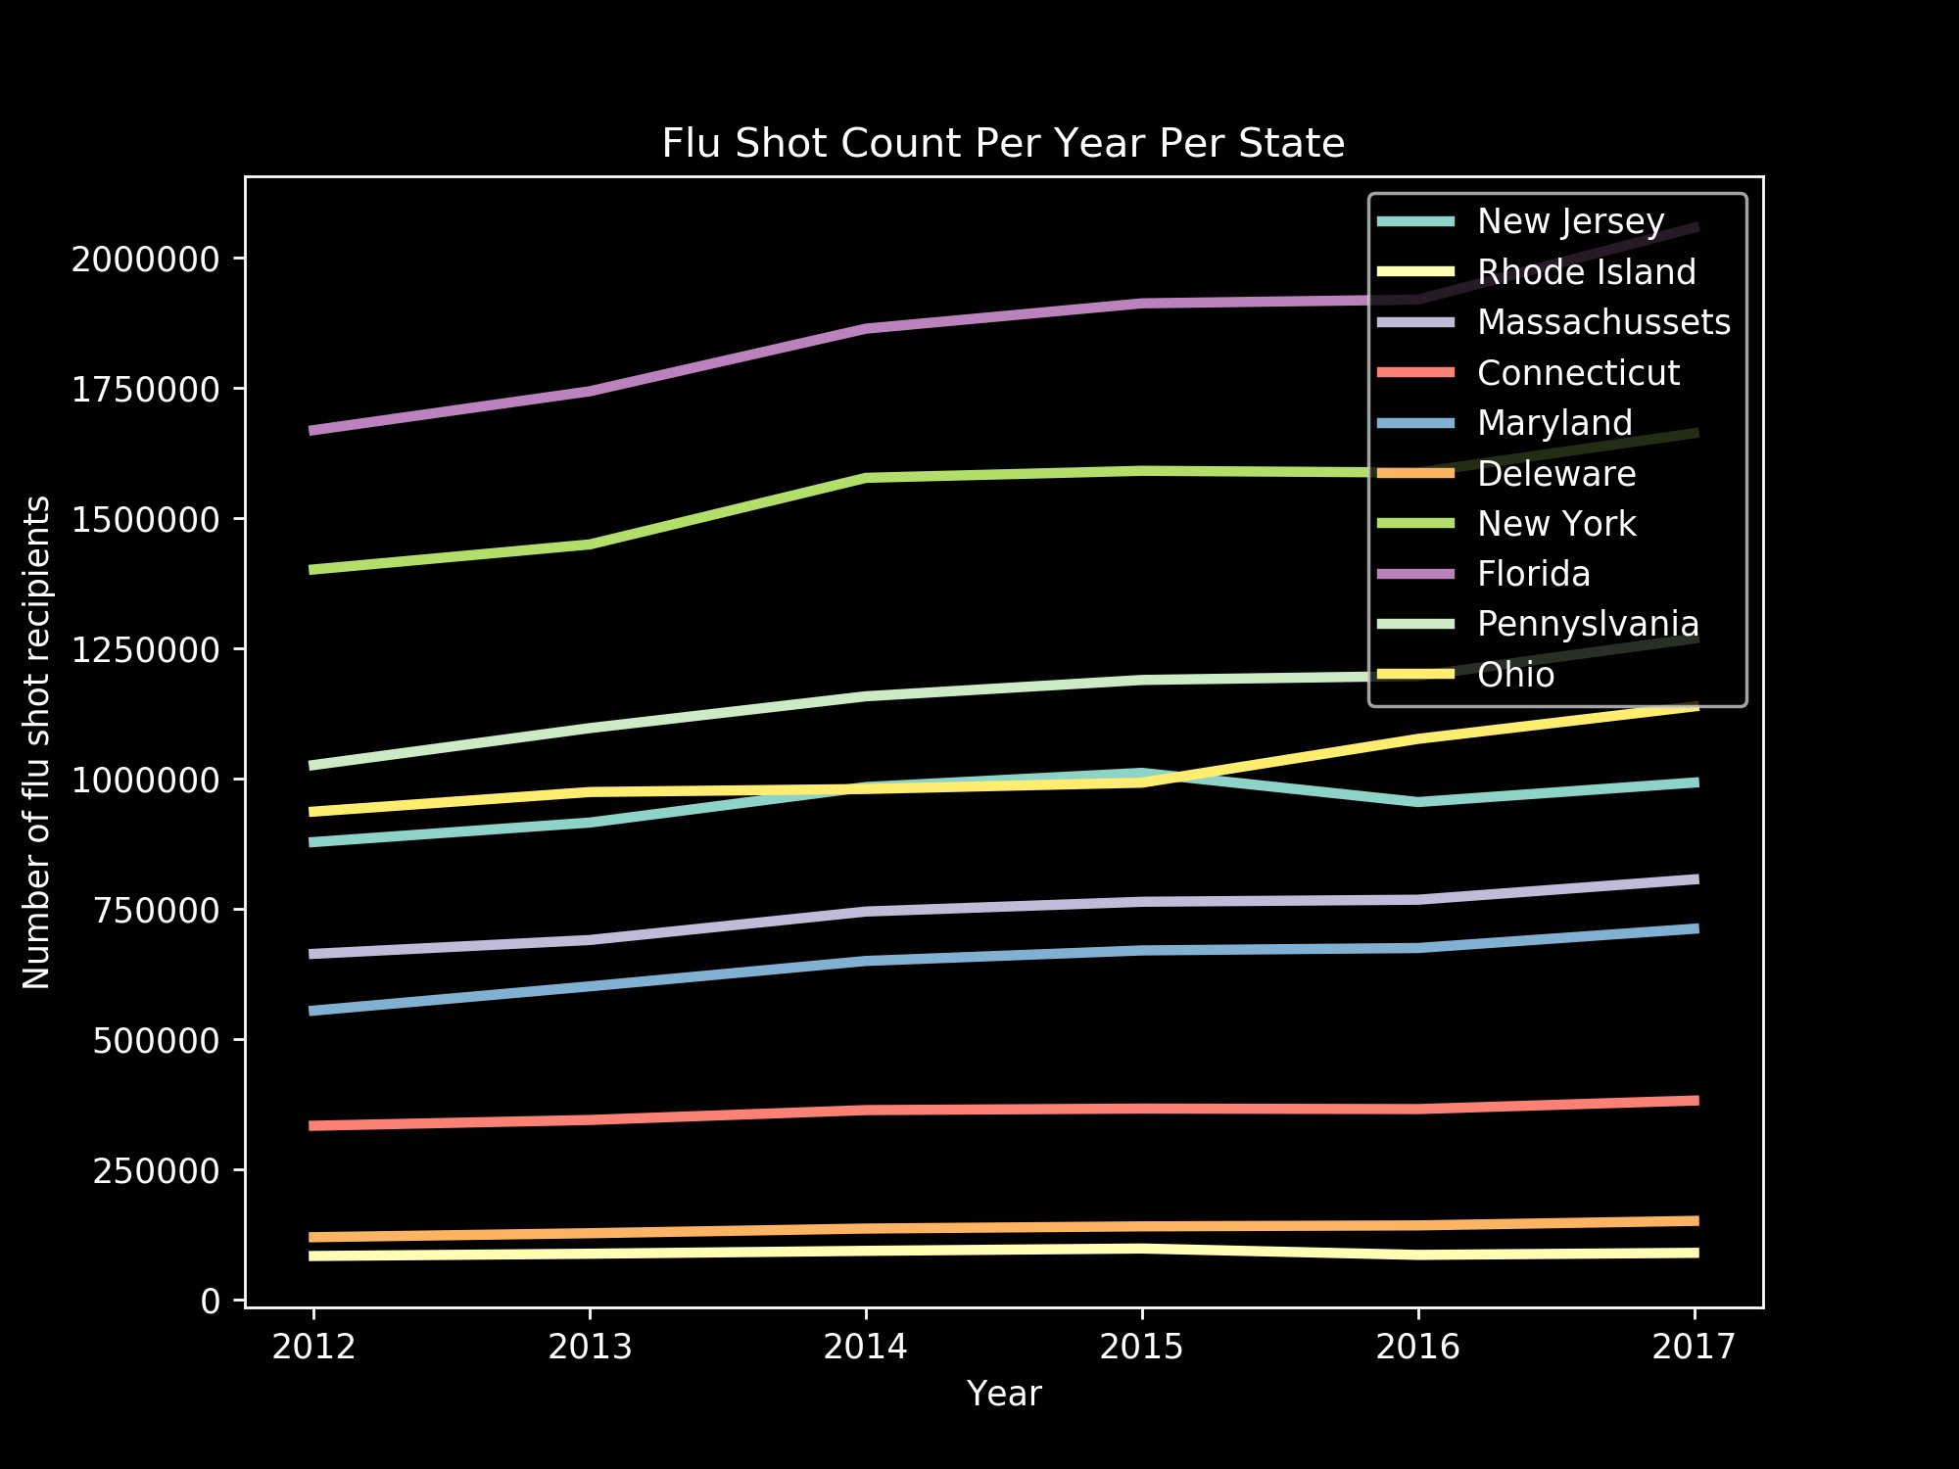

Number of people getting the flu shot is increasing every year
All states are slowly increasing the number of people getting a flu shot every year

Slide 13
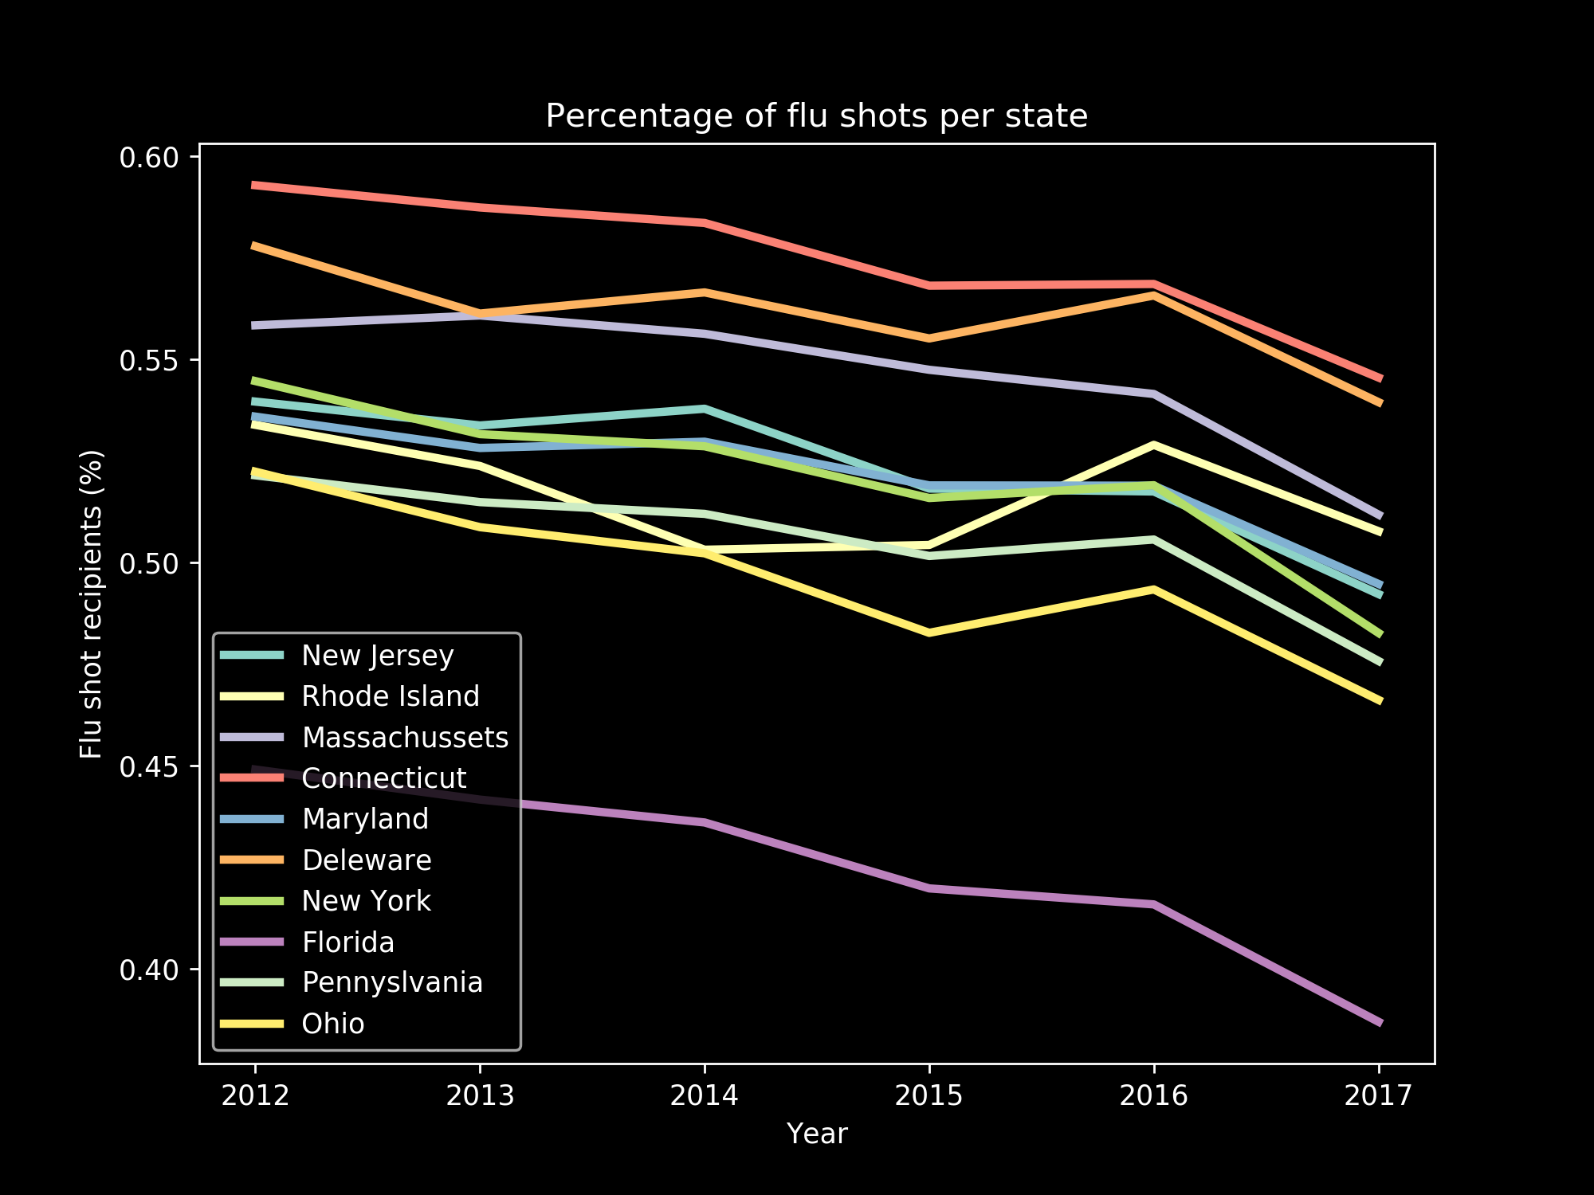

Populations within each state are increasing every year
Federal government recommends a 70% vaccination rate per state.
Florida???

Slide 14
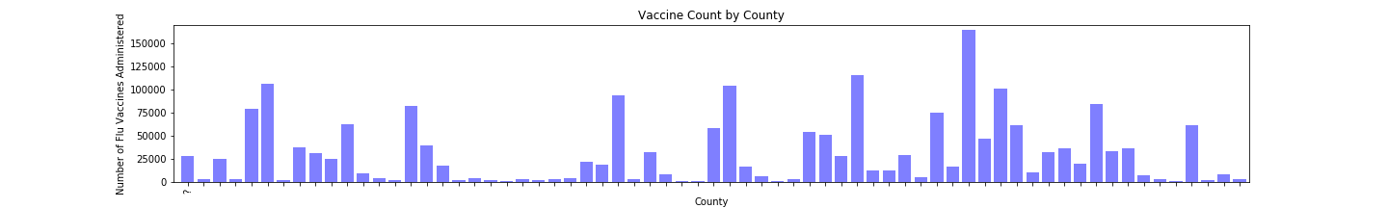
Which Florida county has the gets the most vaccines?

Slide 15
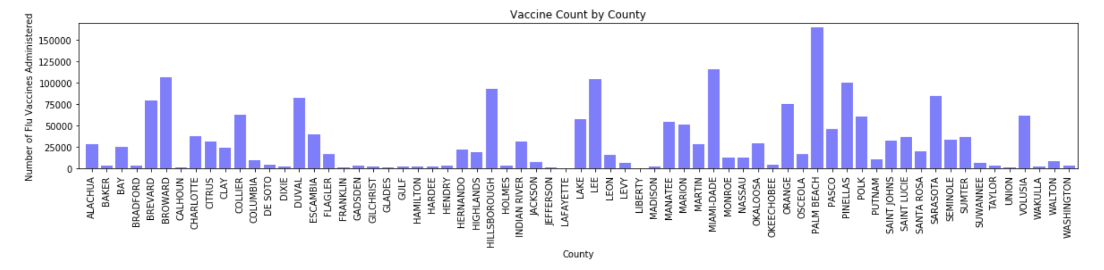
County: Palm Beach
Age Distribution: 21.6% who were 65 years of age or older.
The largest industries: Healthcare & Social Assistance

Slide 16
References
https://www.cdc.gov/flu/about/qa/vaccineeffect.htm
https://fluvaccineapi.hhs.gov/#!/trends/get_vaccination_rates_trends_year_national_json
https://gis.cdc.gov/grasp/fluview/fluportaldashboard.html
https://www.census.gov/data/tables/time-series/demo/health-insurance/historical-series/hic.html

Slide 17
Questions?

